Slide 1
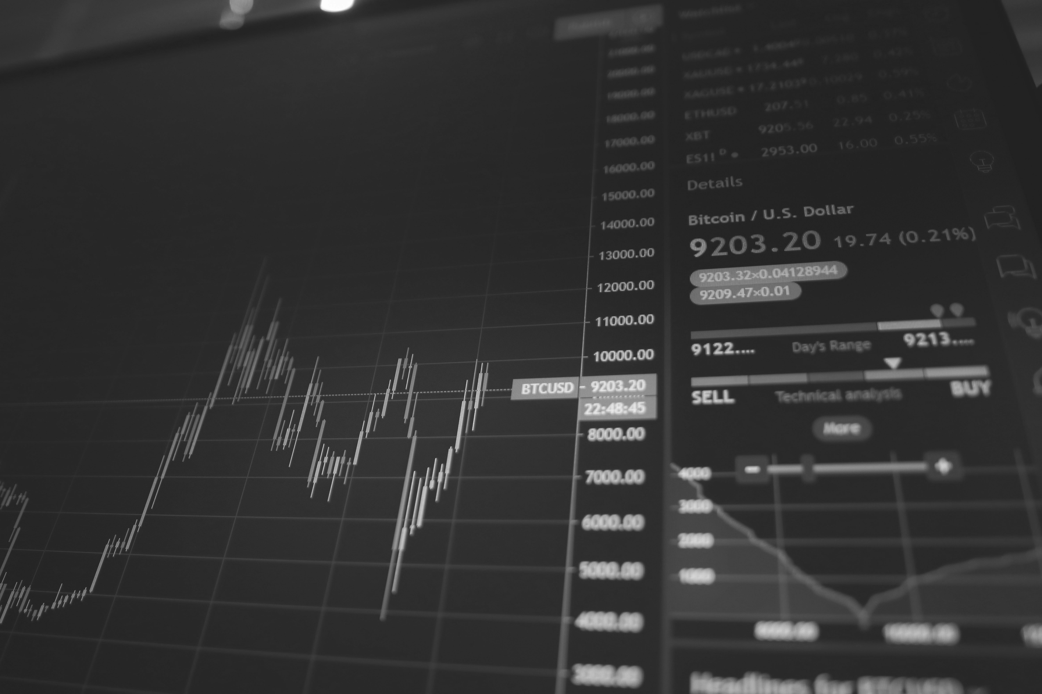
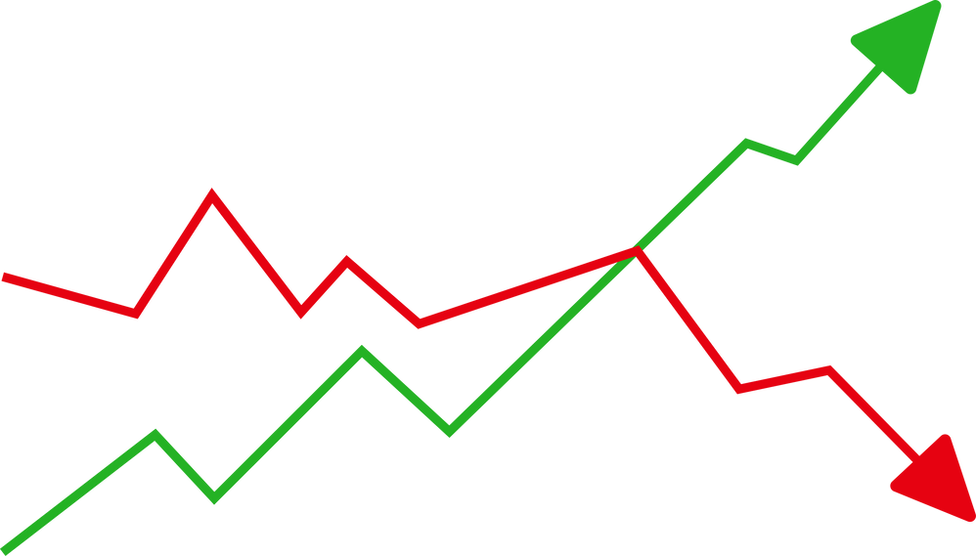
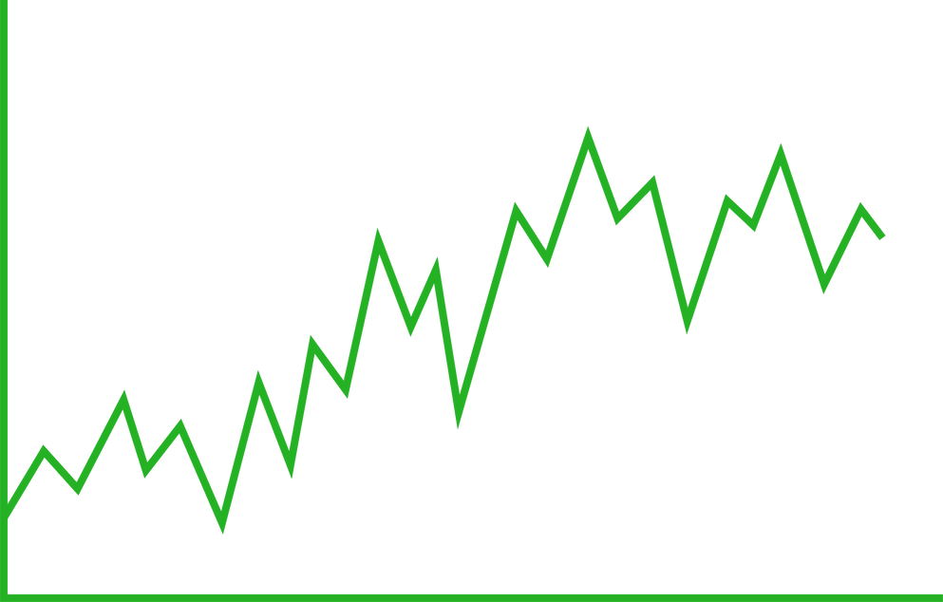
STOCK PRICE
PREDICTION
Presented By: Harshit Arora

Slide 2
OVERVIEW
In this Project, we implement machine learning approach to predict the stock prices. We will be creating a single page web application using “DASH”. Machine learning is purposely implemented in forecasting stock prices. The aim is to predict the stock prices in order to build more informed, accurate decisions for investments.

Slide 3
PROBLEM STATEMENT
Stock investments provide one of the highest returns in the market. Even though they are volatile in nature, a person can visualize share prices and other statistical factors which help investors carefully select on which company they want to spend their hard earned money on.
Developing this simple project using the Dash library, we can make dynamically designed plots of the financial data of specific company by using the tabular data provided by yfinance library. On top of it, we can use a machine learning algorithm to predict the upcoming stock prices.

Slide 4
Purpose
We will be creating a single-page web application using Dash (a python framework) and some machine learning models which will show stock plots based on the stock code given by the user. Also, the ML model enables the user to get stock price prediction for the date inputted by the user.

Slide 5
Hardware
Requirements
Software
Requirements
Technologies
Used
● HTML
● CSS
● PYTHON
● DASH
● MACHINE LEARNING
ALGO
PROCESSOR : Intel i3 core
or latest
RAM: Min. 2 GB RAM
HARD DISK: Min. 10GB
Text Editor: VS Code
Framework: DASH
Language Used: Python
Presentations can be used as lectures, lectures, speeches, reports, and many others.
Presentations can be used as lectures, lectures, speeches, reports, and many others.
Presentations can be used as lectures, lectures, speeches, reports, and many others.

Slide 6



MODULES
01
02
03
STOCK_PRICE
INDICATORS
FORECAST
The "stock_price" module involves the download of stock data and the generation of a graph displaying the stock price over a chosen date range.
The "indicators" module focuses on downloading stock data and generating a graph that showcases the Exponential Moving Average (EMA) indicator.
The "forecast" topic enables the generation of a stock price forecast graph. The algorithm generates a graph that predicts the future price movement of the stock.

Slide 7
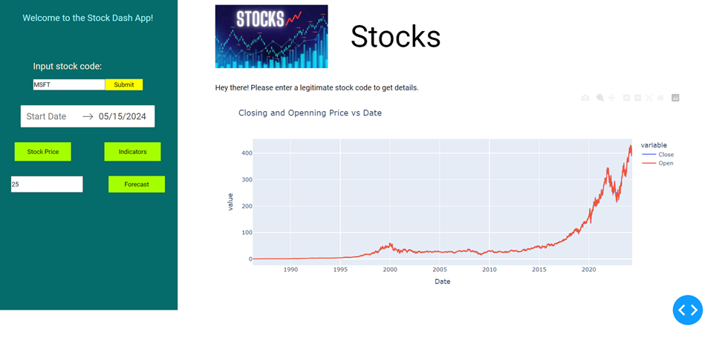
Screenshot Demonstration

Slide 8
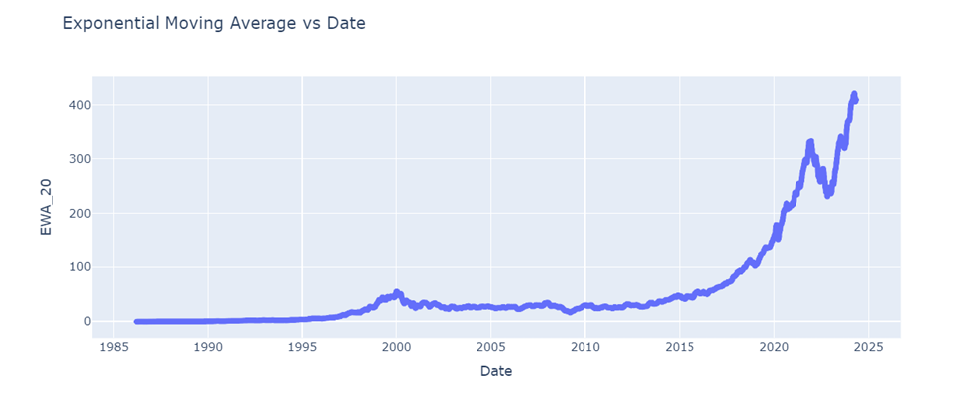

Slide 9
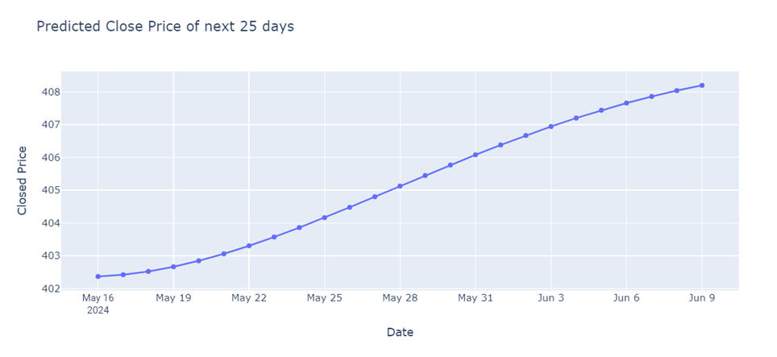

Slide 10
CONCLUSION
The motivation was to propose a application which will be able to produce good stock price prediction results. This study is done by combining different kinds of windowing function with a support vector machine. This is a new way to apply different kinds of windowing function as data pre-processing step to feed the input into the machine learning algorithm for pattern recognition.

Slide 11

FUTURE WORK
I am thankful for being provided this great opportunity to work on it. As already mentioned, this project has gone through extensive research work. On the basis of the research work, we have successfully designed and implemented a Stock prediction application. In the future, some other windowing functions will be applied as input selection technique in order to improve the prediction performance of our proposed SVR model’s and the results will be compared with other data mining techniques by applying different dataset from different stock index.

Slide 12

References
https://www.w3schools.com/
https://stackoverflow.com/
https://dash.plotly.com/
https://www.youtube.com/
https://www.geeksforgeeks.org/

Slide 13
THANK YOU

